Slide 1
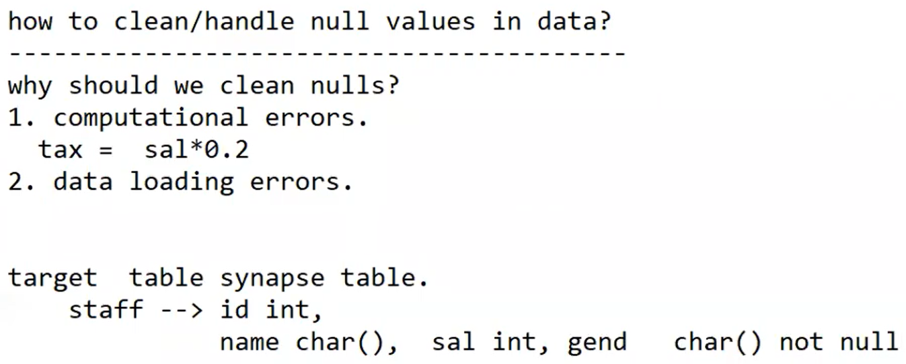

Slide 2
iif(condition, true value, false value)
Iif(isNull(sal), 0, sal)

Slide 3
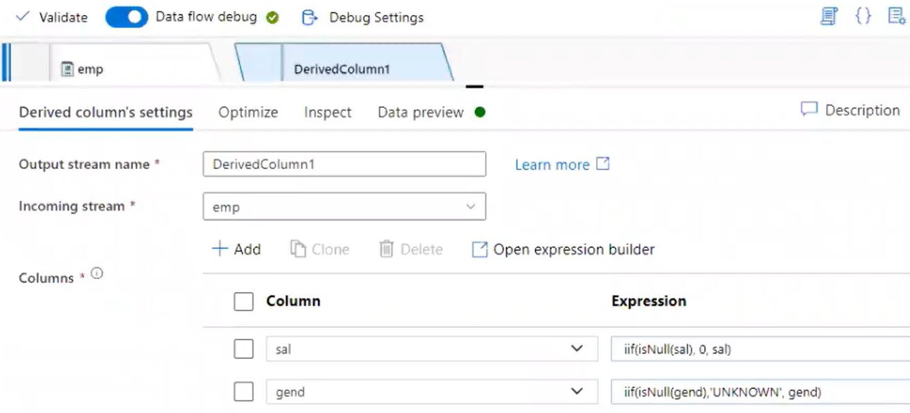
sal
iif(isNull(sal), 0, sal)
gend
iif(isNull(gend), ‘UNKNOWN”, gend)

Slide 4
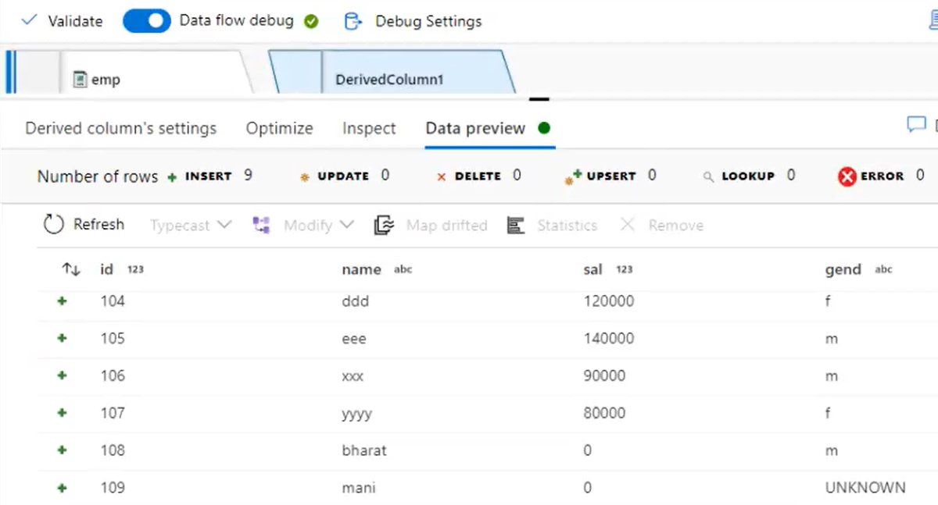

Slide 5
IifNull(sal, 0)
iifNull(gend, ‘UNKNOWN”)

Slide 6
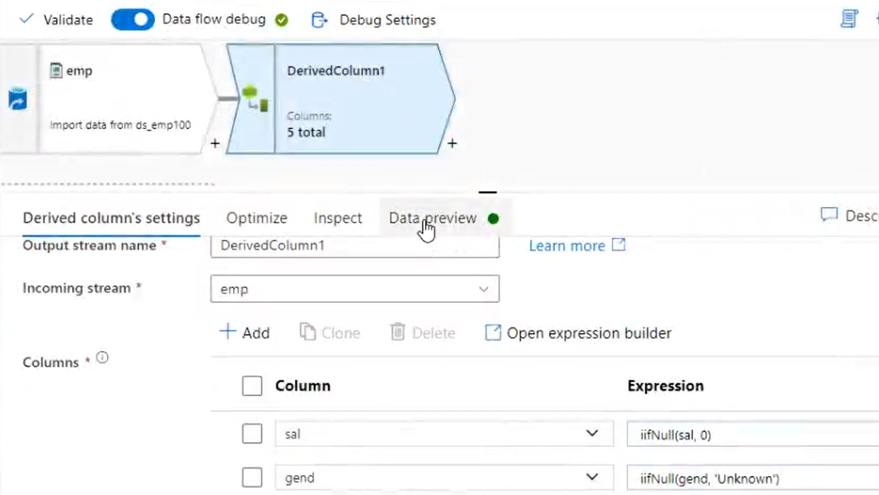
sal
iifNull(sal, 0)
gend
iifNull(gend, ‘UNKNOWN”)

